Slide 1


Lobateness of Martian Ejecta Craters Using Thermal Imaging
Nicholas Kutsop
Dr. Nadine G. Barlow
NASA Space Grant
Northern Arizona University Department of Physics and Astronomy

Slide 2
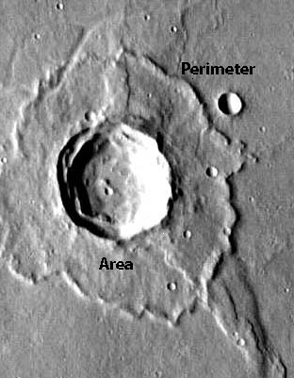
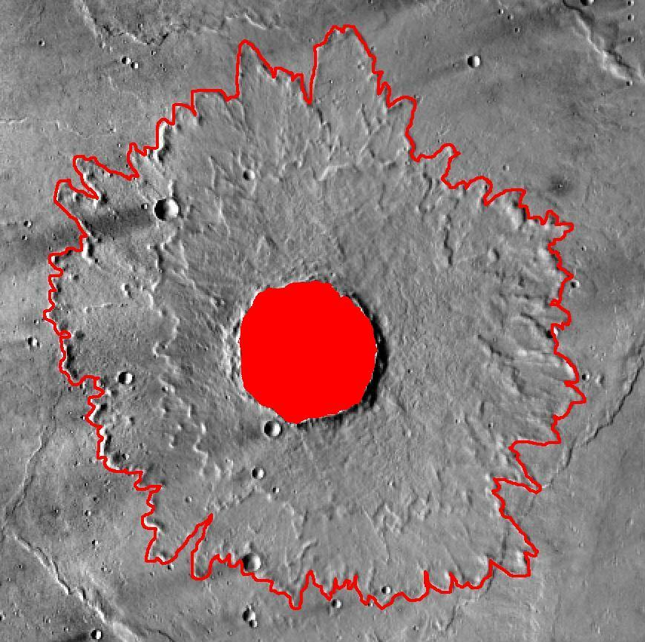
Some info
Lobateness→ Sinuosity→ How Flowery vs Circular the Ejecta Blanket Looks
Γ=P/(4πA)^{1/2}
THEMIS - Thermal Emission Imaging System

Slide 3
As one increases in latitude, one would expect an increase in water ice content in the near surface region, leading one to expect to observe a proportional increase in lobateness of the ejecta.
Original Proposition

Slide 4
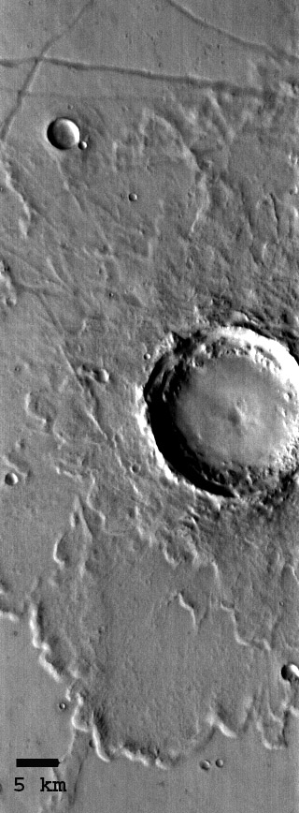
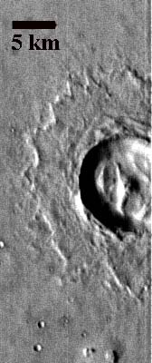
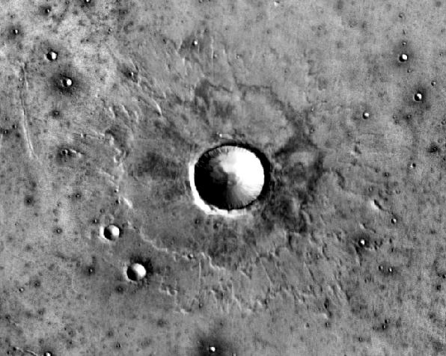
MLER,DLER,SLER

Slide 5
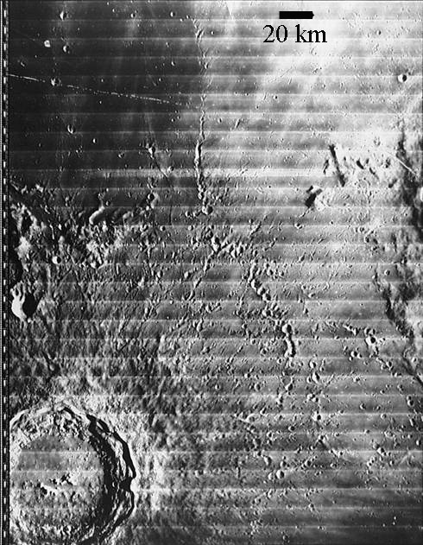
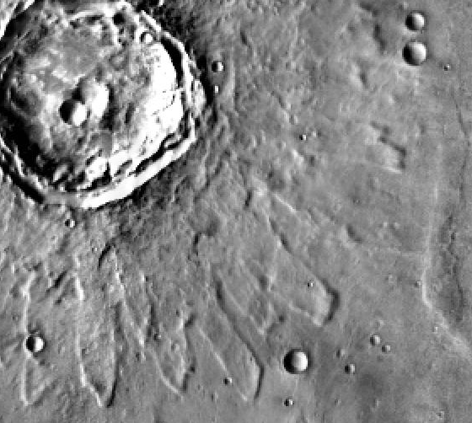
Ok well why?
Martian craters differ significantly from those on the Moon or Mercury
Lunar Ballistic
Martian Rampart
Could be due to atmospheric turbulence following impact, or could be due to volatiles in the regolith
Atmospheric theory falls short following investigation of icy satellites

Slide 6
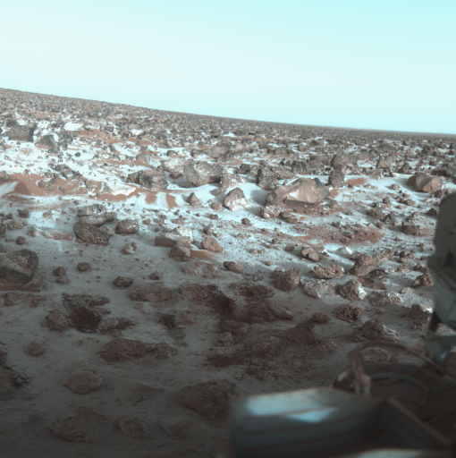
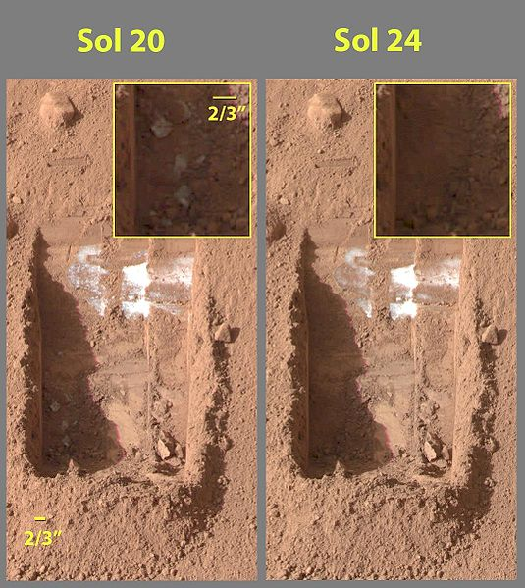
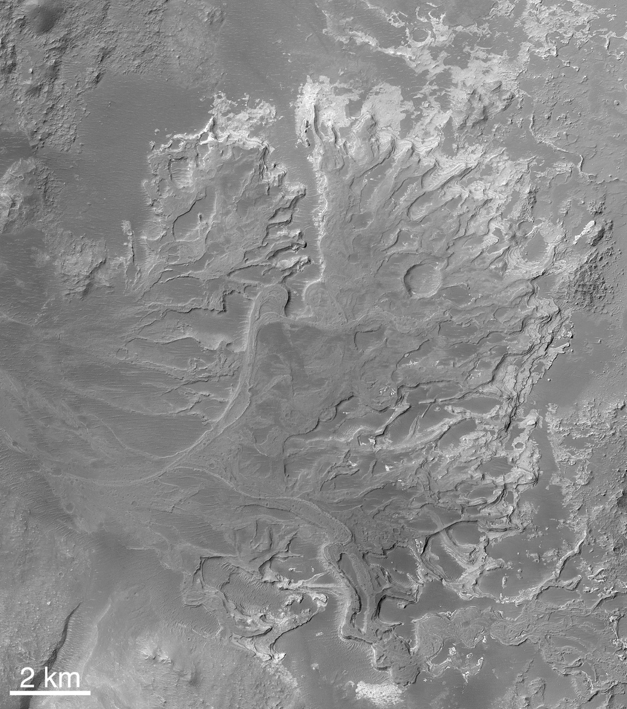
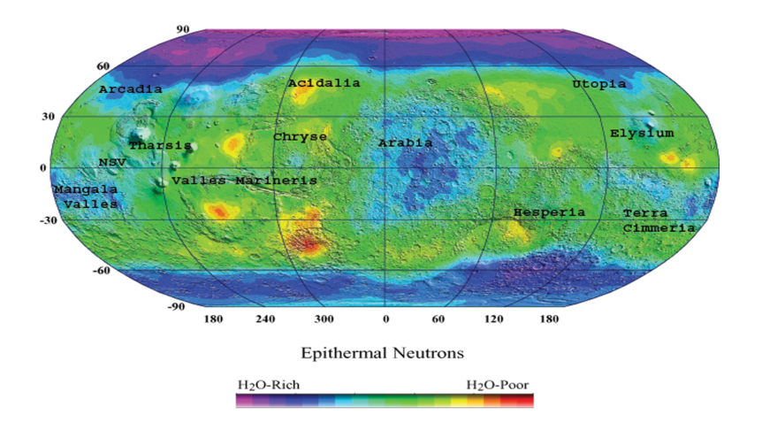
What does it mean?
Water ice on Mars? (Snapshots in Time)
Water deep below the surface? (Mother Natures Tunnel Boring Machine)

Slide 7
A new look for old data
THEMIS resolution (100m/p)
vs.
Viking resolution (300m/p)
Layer types lobateness consistent with previous studies
Multiple differences between 1994 and 2010 data
Layer Type | Lobateness
MLER AVG | 1.56
MLER MIN | 1.15
MLER MAX | 2.18
SLER AVG | 1.35
SLER MIN | 1.10
SLER MAX | 2.24

Slide 8
Significant Differences
382 SLER, 137 MLER, 519 Total from 0-30°
2008 SLER, 937 MLER, 2945 Total from 0-30°
Average % Difference = 77.446
Layer Type | Median Values as of 1994
MLER Median 0-10 N | 1.19
MLER Median 10-20 N | 1.19
MLER Median 20-30 N | 1.19
SLER Median 0-10 N | 1.10
SLER Median 10-20 N | 1.10
SLER Median 20-30 N | 1.11
Layer Type | Median Values as of 2012
MLER Median 0-10 N | 1.54
MLER Median 10-20 N | 1.48
MLER Median 20-30 N | 1.42
SLER Median 0-10 N | 1.54
SLER Median 10-20 N | 1.48
SLER Median 20-30 N | 1.42

Slide 9
The data thus far…

Slide 12
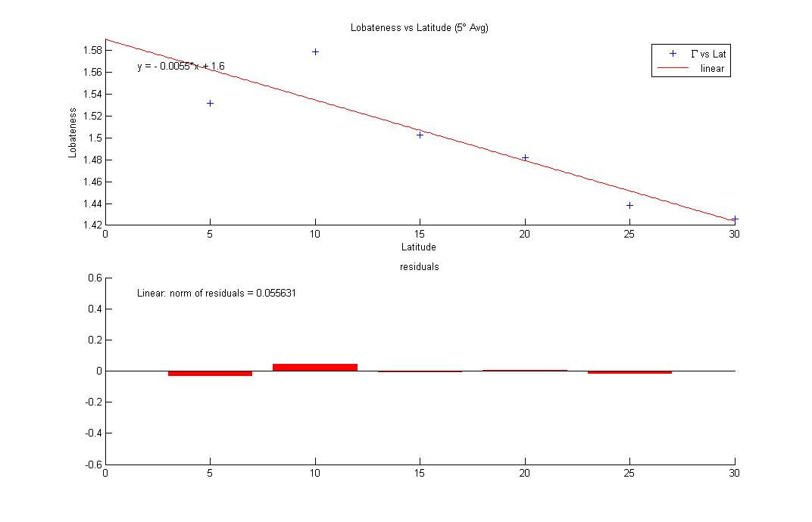
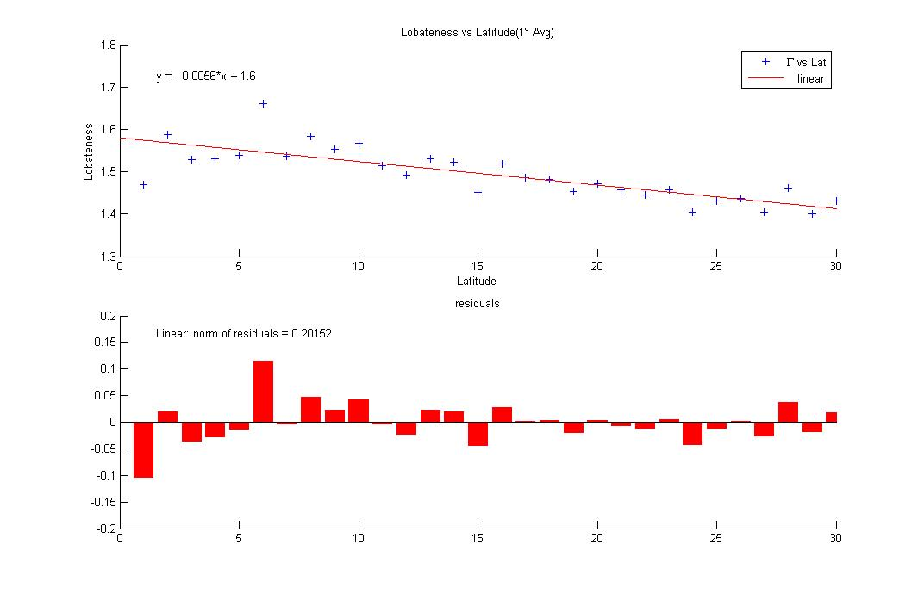
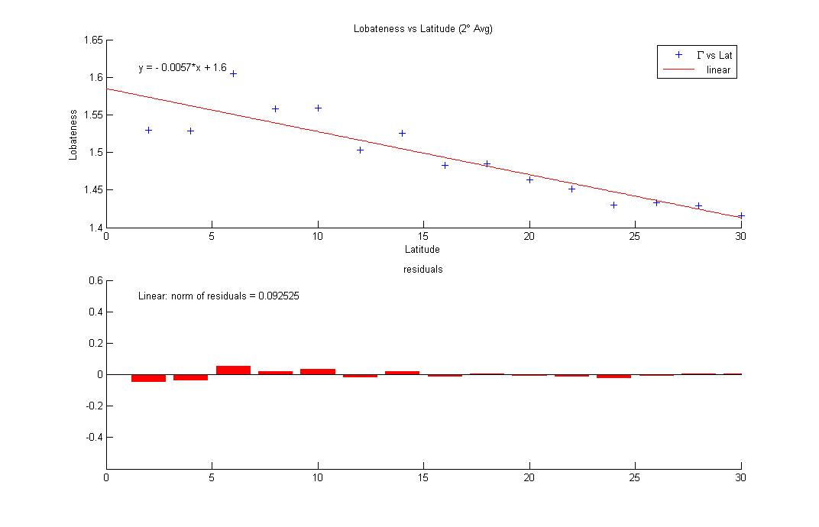

Slide 14
Γ=NEGATIVE(≈.0055)Lat+1.6?

Slide 15
Where are we and what next?
Is the previously put forth model for lobateness accurate?
What new hypothesis can we generate from this data?
Lobateness at higher latitudes
The southern hemisphere
Compare to older data
Correlation between age and lobateness

Slide 16
And thank you…
Dr. Nadine G Barlow
NAU Department of Physics and Astronomy
NASA Space Grant
Wikipedia for the pictures
MatLab for the graphs
The team of JMars

Slide 17
Quick Info
Total Craters = 3029
DLER=3%
SLER=66%
MLER=31%
Residual = Goodness of Fit

Slide 18
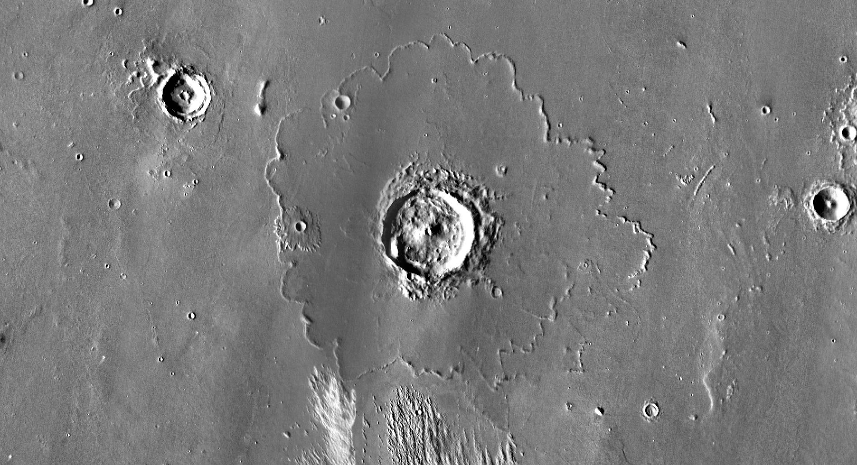
Bonus Pictures

Slide 19
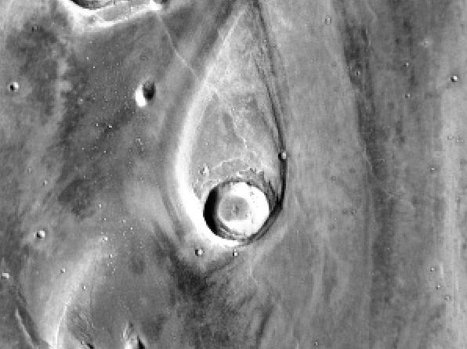

Slide 20
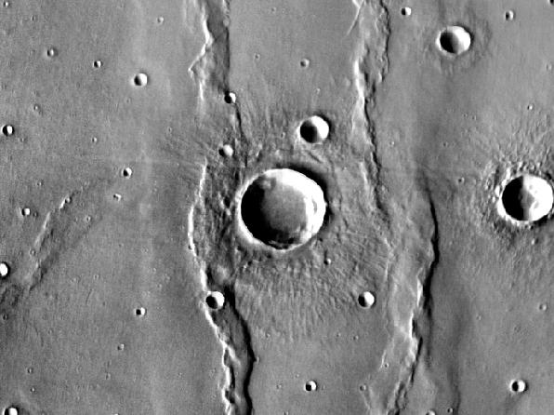

Slide 21
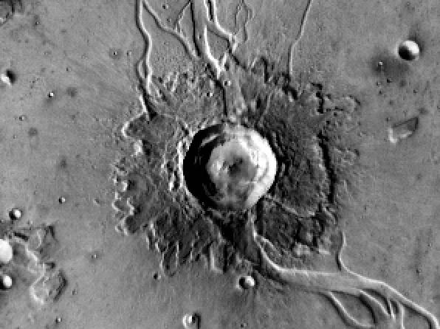

Slide 22
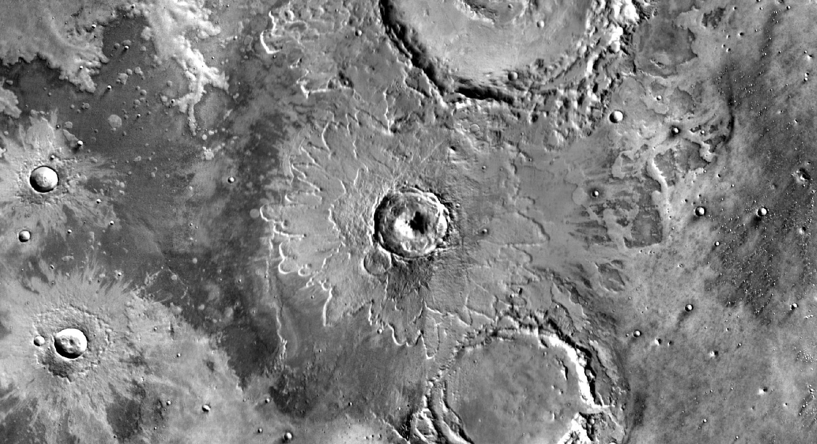

Slide 23
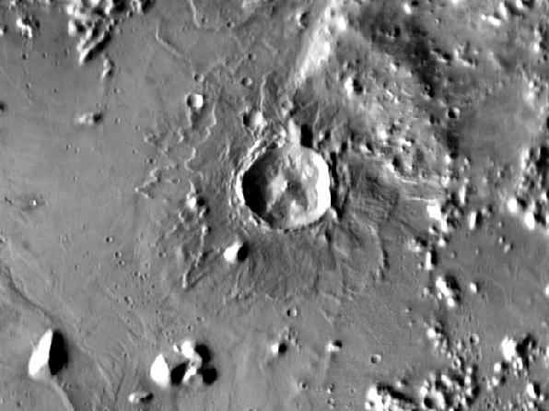

Slide 24
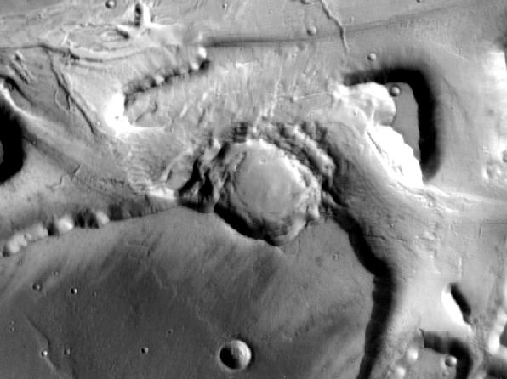

Slide 25
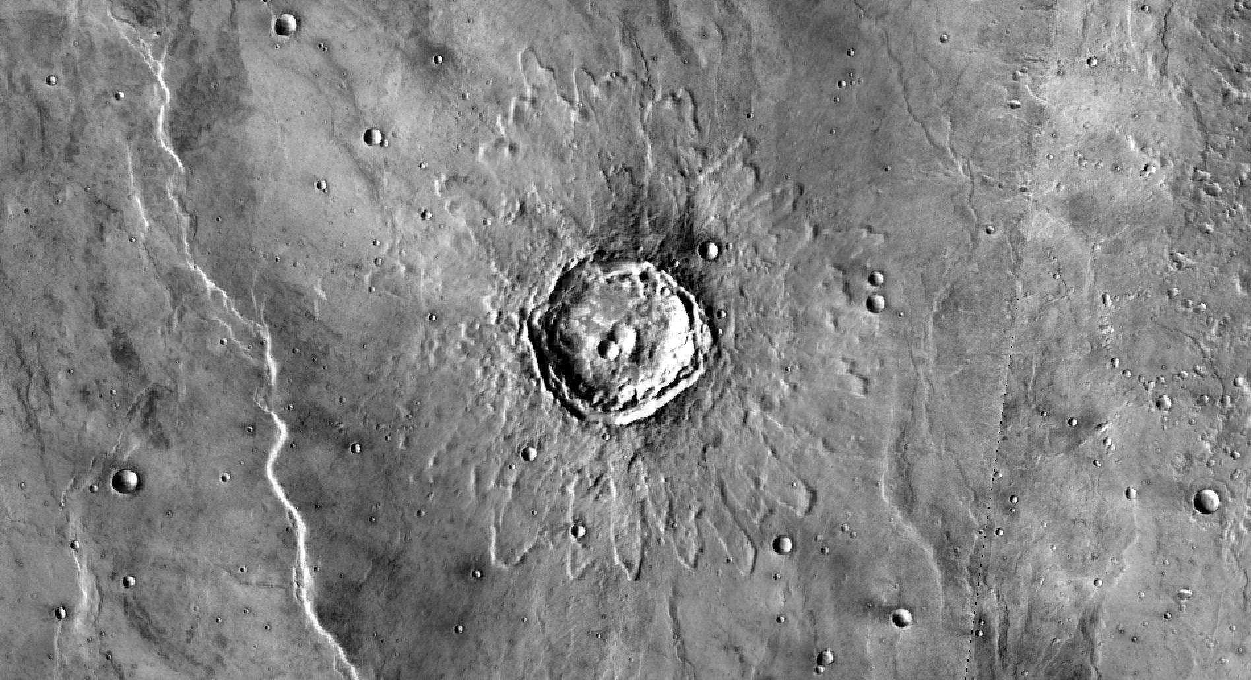

Slide 26
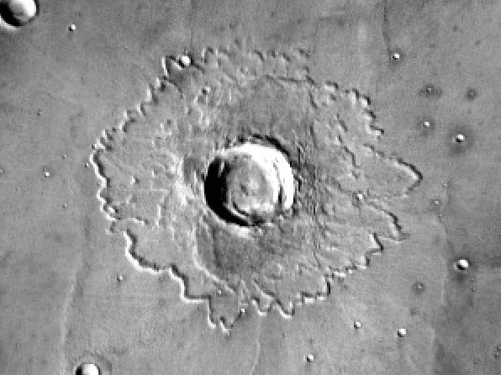

Slide 27
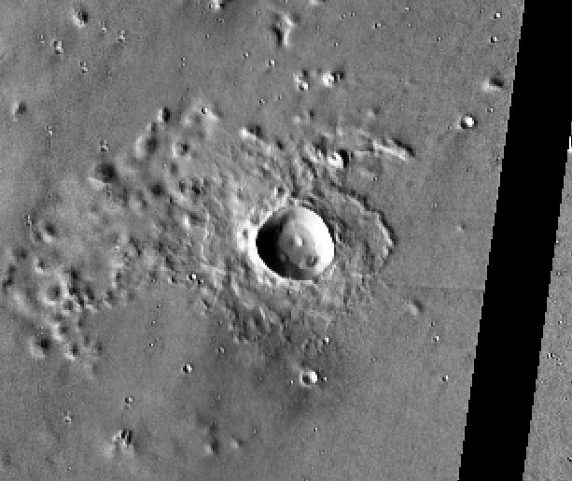
MLER Avg

Slide 28
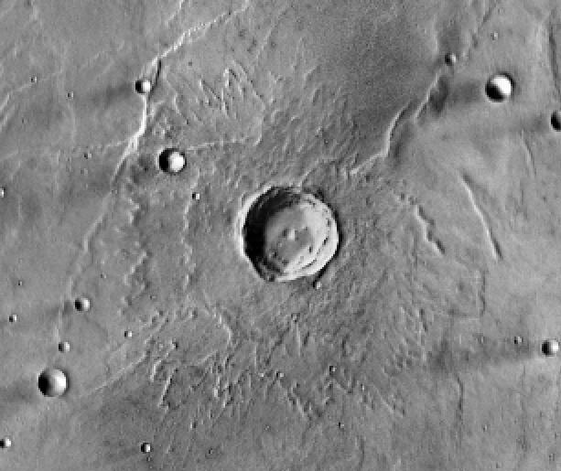
MLER Max

Slide 29
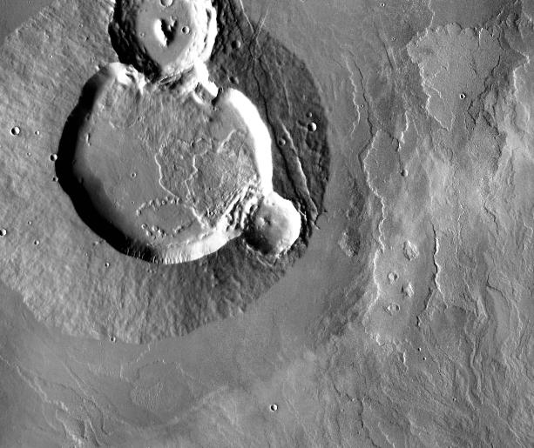
MLER Min

Slide 30
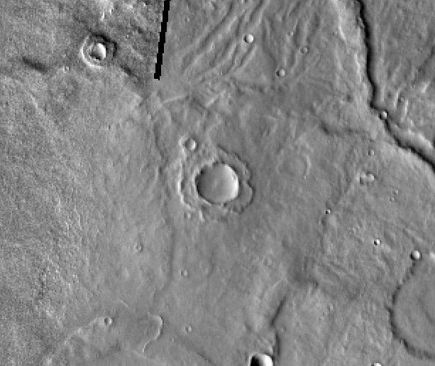
SLER Avg

Slide 31
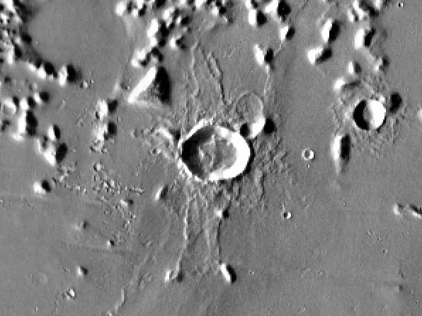
SLER Max

Slide 32
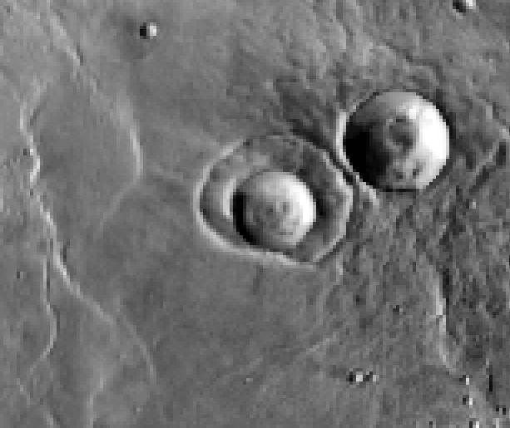
SLER Min

